Slide 1
CONSTRUCTION ADMINISTRATION
REVIT University
AFTER THE PERMIT….
ORB UNIVERSITY – 11,15 2023 PRESENTED BY Andres Fernandez

Slide 2
CONSTRUCTION ADMINISTRATION
VOCABULARY:
RFI: REQUEST FOR INFORMATION
ASK, SK: ARCHITECTURAL SKETCH
ASI: ARCHITECTS SUPLEMENTAL INFORMATION
DELTA Δ: NOTED UPDATES IN CONSTRUCTION DOCUMENTS RELATED TO A SPECIFIC ITEM AND DATE.
FIELD REPORTS: SNAPSHOT IN TIME OF PROJECT PROGRESS
SUBMITTALS: DOCUMENTS PROVIDED BY THE CONTRACTOR TO ORB FOR AN APPROVAL OF USE
SUBTITUTION REQUEST: CHANGES IN PRODUCTS, MATERIALS, EQUIPMENT, AND METHODS OF CONSTRUCTION REQUIRED BY CONTRACT DOCUMENTS PROPOSED BY CONTRACTOR
CYA: COVER YOUR ASSETS

Slide 3
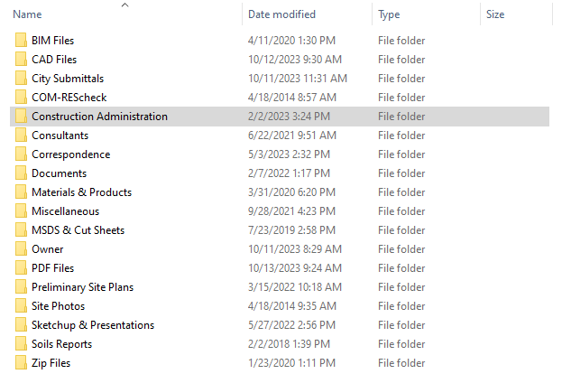
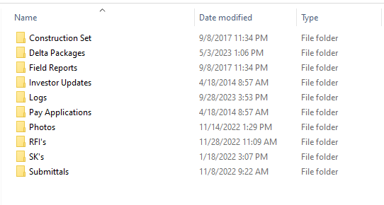
CONSTRUCTION ADMINISTRATION

Slide 4
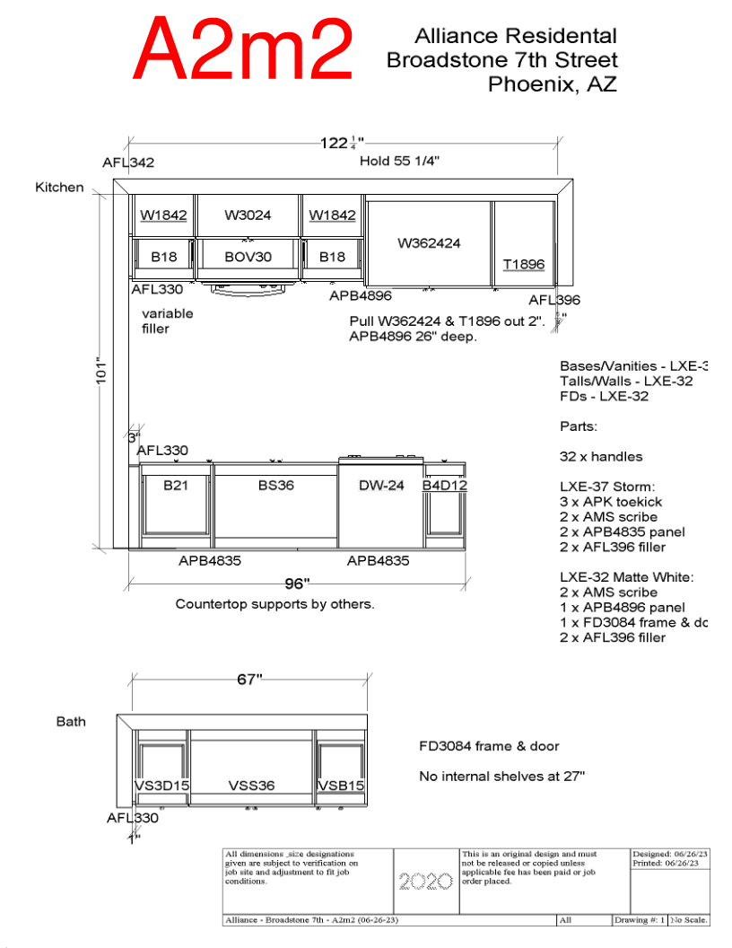
CONSTRUCTION ADMINISTRATION
SUBMITTALS:
DOCUMENTS PROVIDED BY THE CONTRACTOR TO ORB FOR AN APPROVAL OF USE
SHOP DRAWINGS
PRODUCT DATA
SAMPLES

Slide 5
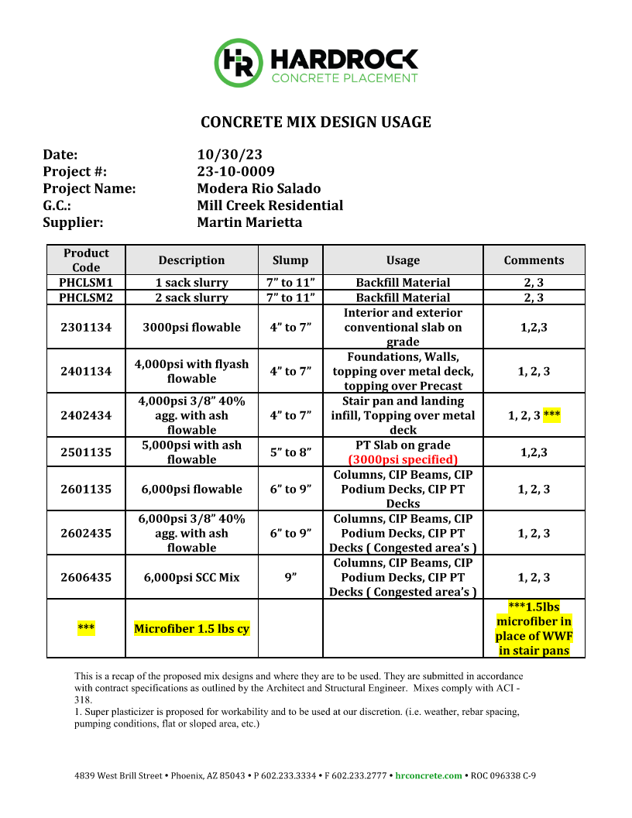
CONSTRUCTION ADMINISTRATION
SUBMITTALS:
SHOP DRAWINGS
SUBMITTALS:
DOCUMENTS PROVIDED BY THE CONTRACTOR TO ORB FOR AN APPROVAL OF USE
SHOP DRAWINGS
PRODUCT DATA
SAMPLES

Slide 6
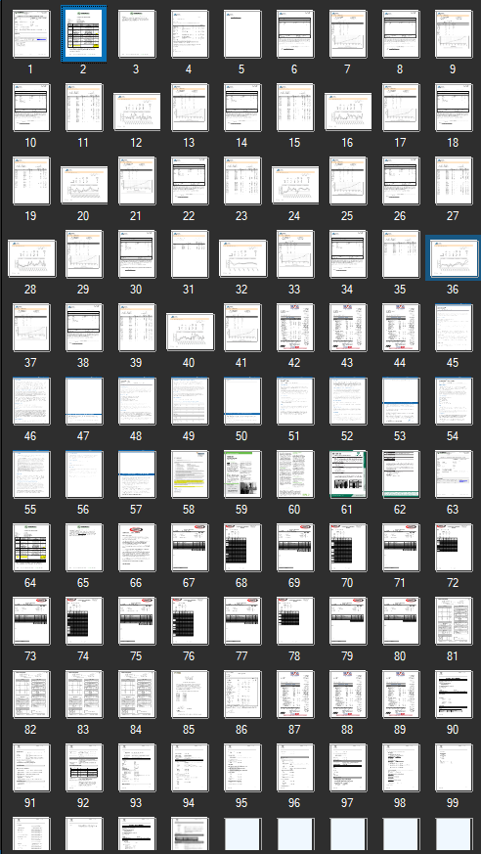
CONSTRUCTION ADMINISTRATION
SUBMITTALS:
PRODUCT DATA
SUBMITTALS:
DOCUMENTS PROVIDED BY THE CONTRACTOR TO ORB FOR AN APPROVAL OF USE
SHOP DRAWINGS
PRODUCT DATA
SAMPLES

Slide 7
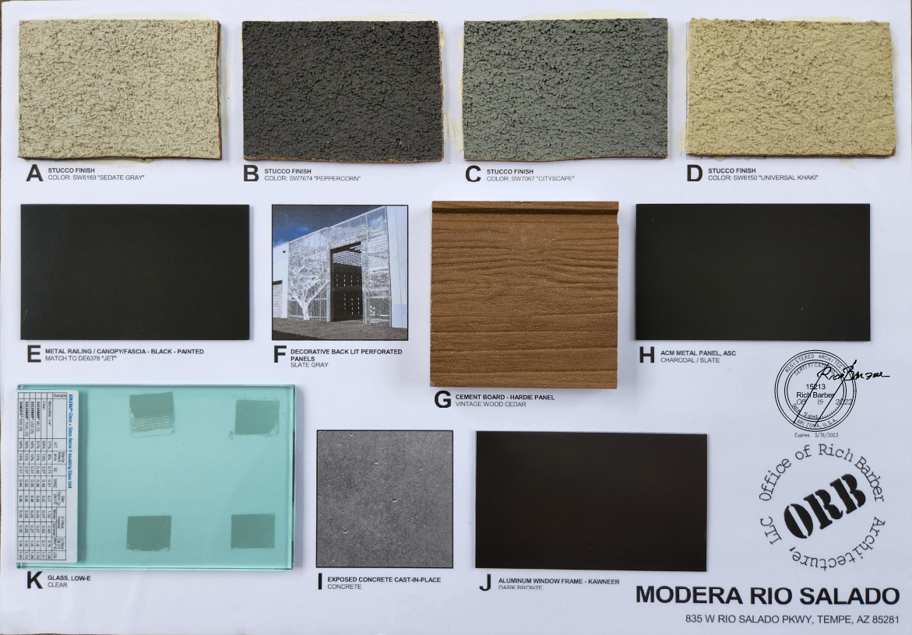
CONSTRUCTION ADMINISTRATION
SUBMITTALS:
PRODUCT DATA

Slide 8
CONSTRUCTION ADMINISTRATION
SUBMITTALS:
SAMPLES

Slide 9
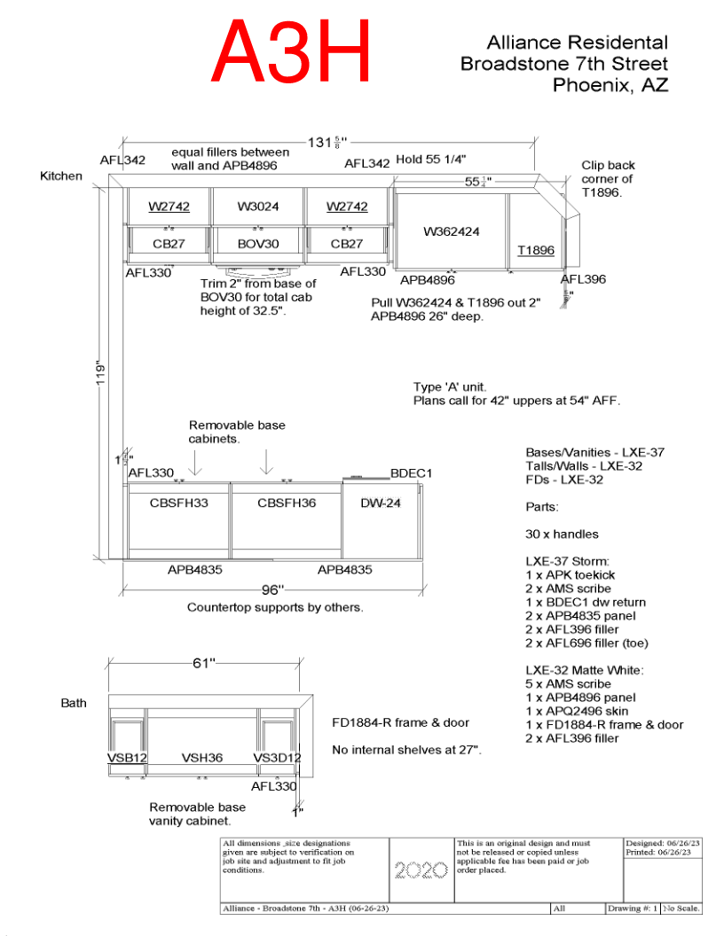
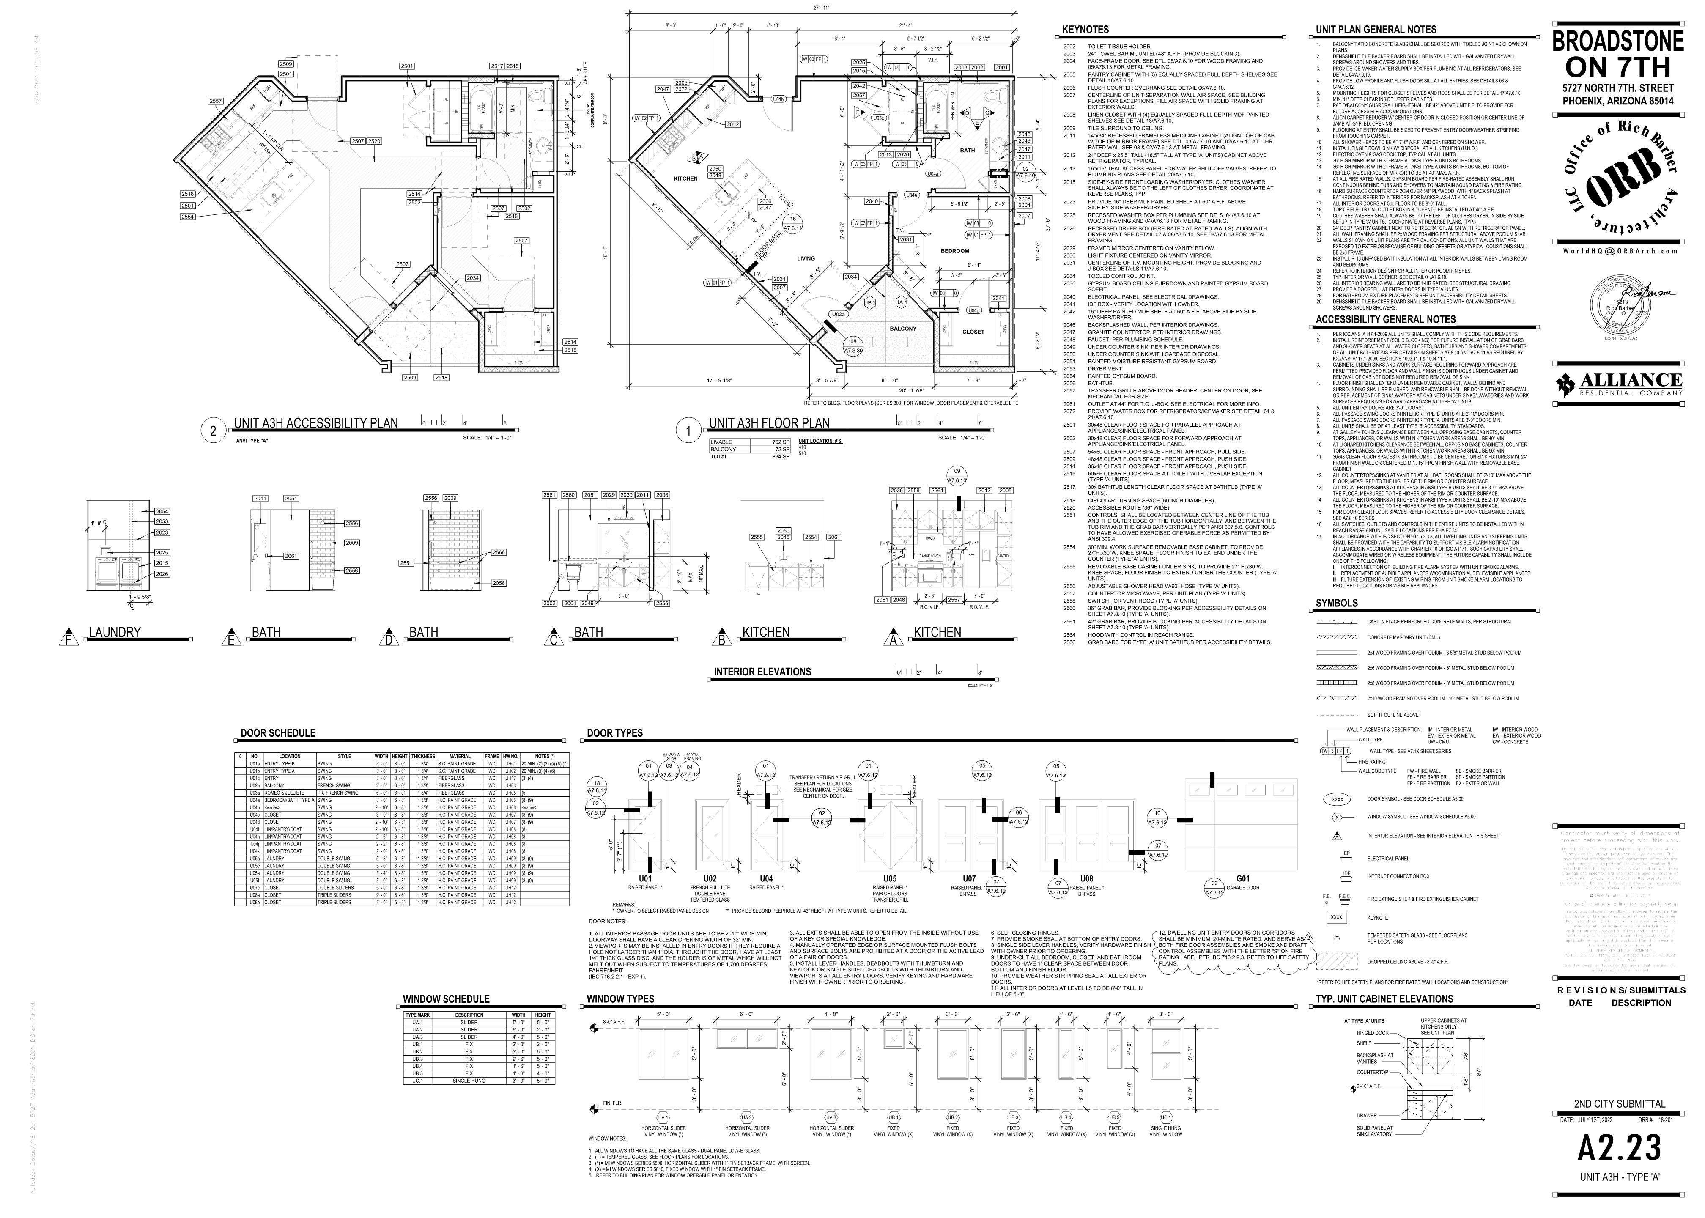
CONSTRUCTION ADMINISTRATION
REVIEW ALL DOCUMENTATION IN SUBMITTAL
COMPARE WITH CONSTRUCTION DOCUMENTS AT ALL LOCATIONS
SUBMITTALS:
SHOP DRAWINGS
UNDERSTAND THE PARTICULAR LANGUAGE OF THE SUBMITTAL
UNITS
TERMINOLOGY

Slide 10
REVIEW ALL DOCUMENTATION IN SUBMITTAL
CONSTRUCTION ADMINISTRATION
COMPARE WITH CONSTRUCTION DOCUMENTS AT ALL LOCATIONS
SUBMITTALS:
SHOP DRAWINGS
UNDERSTAND THE PARTICULAR LANGUAGE OF THE SUBMITTAL
UNITS
TERMINOLOGY

Slide 11
REVIEW ALL DOCUMENTATION IN SUBMITTAL
CONSTRUCTION ADMINISTRATION
COMPARE WITH CONSTRUCTION DOCUMENTS AT ALL LOCATIONS
SUBMITTALS:
SHOP DRAWINGS
UNDERSTAND THE PARTICULAR LANGUAGE OF THE SUBMITTAL
UNITS
TERMINOLOGY

Slide 12
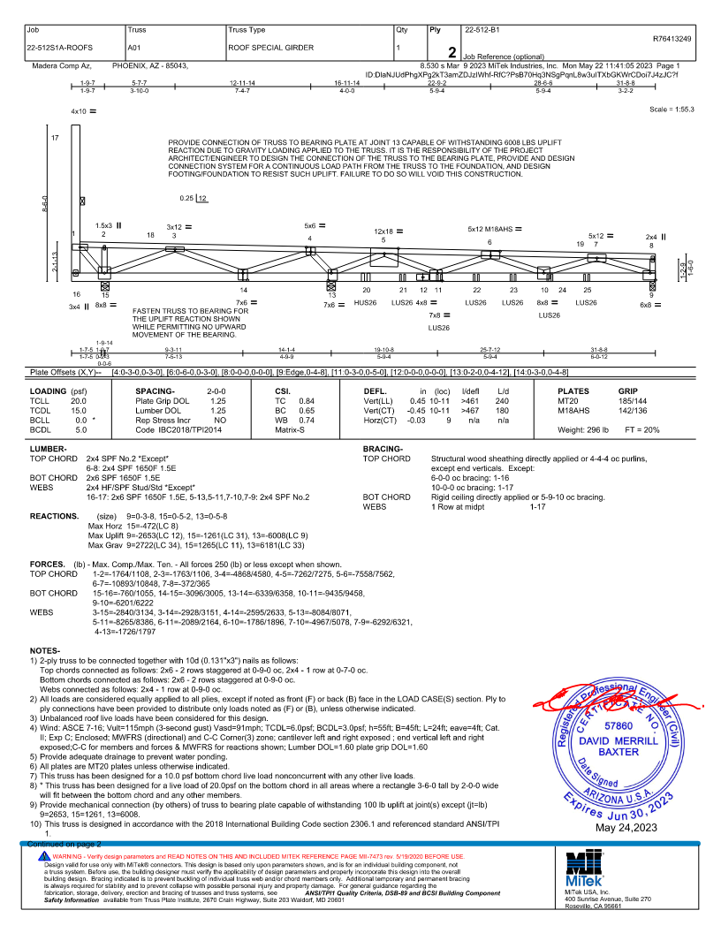
COMPARE WITH CONSTRUCTION DOCUMENTS AT ALL LOCATIONS
CONSTRUCTION ADMINISTRATION
UNDERSTAND THE PARTICULAR LANGUAGE OF THE SUBMITTAL
UNITS
TERMINOLOGY
SUBMITTALS:
SHOP DRAWINGS

Slide 13
CONSTRUCTION ADMINISTRATION
UNDERSTAND THE PARTICULAR LANGUAGE OF THE SUBMITTAL
UNITS
TERMINOLOGY
SUBMITTALS:
SHOP DRAWINGS
FINAL COORDINATION OF SUBMITTAL SCOPE WITH OTHER DISCIPLINES

Slide 14
UNDERSTAND THE PARTICULAR LANGUAGE OF THE SUBMITTAL
UNITS
TERMINOLOGY
CONSTRUCTION ADMINISTRATION
FINAL COORDINATION OF SUBMITTAL SCOPE WITH OTHER DISCIPLINES AND BUILDING CODES
SUBMITTALS:
SHOP DRAWINGS

Slide 15
CONSTRUCTION ADMINISTRATION
FINAL COORDINATION OF SUBMITTAL SCOPE WITH OTHER DISCIPLINES AND BUILDING CODES
SUBMITTALS:
SHOP DRAWINGS

Slide 16
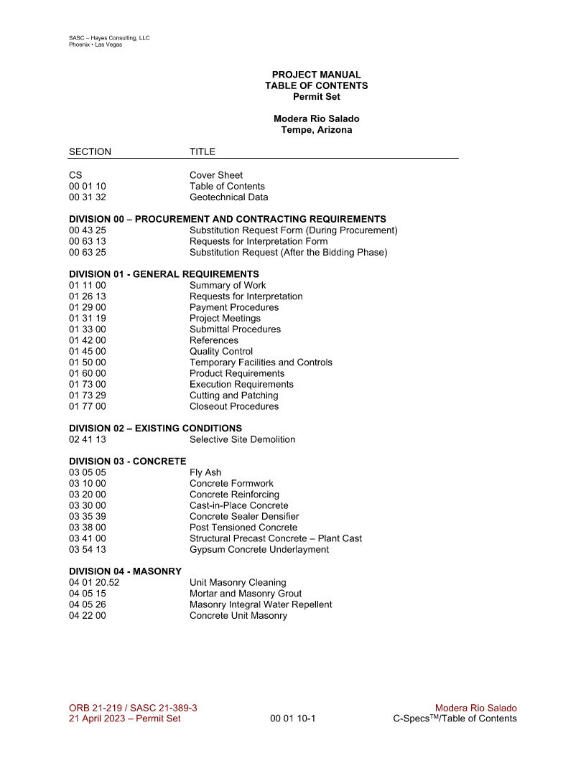
CONSTRUCTION ADMINISTRATION
REVIEW SAMPLES ACROSS ALL DOCUMENTATION
DR SUBMITTALS / APPROVALS
CONSTRUCTION DOCUMENTS
SUBMITTALS:
SAMPLES

Slide 17
CONSTRUCTION ADMINISTRATION
SUBMITTALS CAN BE ACOMPANIED BY A PROJECT SPECIFICATION BOOK.
SPECIFICATIONS WILL FOLLOW THE CSI DIVISION SYSTEM.
ALL SUBMITTALS WILL BE COMPARED TO THE SPECIFICATIONS BOOK.
IF DISCREPANCIES OCCUR, THEN THE CONTRACTOR MUST PROVIDE A SUBSTITUTION REQUEST.

Slide 18
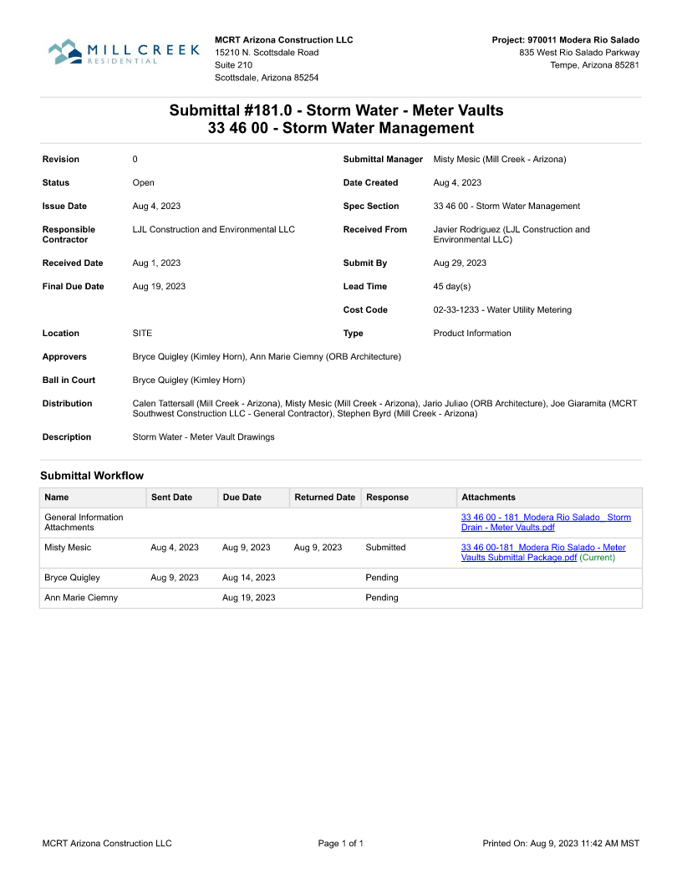
CONSTRUCTION ADMINISTRATION
SPECIFICATION BOOK:
ITEMS THE CONTRACTOR WILL USE TO FINISH THE PROJECT
PROCEDURES ON HOW AND WHEN SUBMITTALS ARE PROVIDED
MINIMUM REQUIREMENTS OF:
INSTALLATION
FABRICATION
EXECUTION
PRODUCT REQUIREMENTS
PROCEDURES FOR APPROVAL
PROCEDURES FOR SUBSTITUTIONS

Slide 19
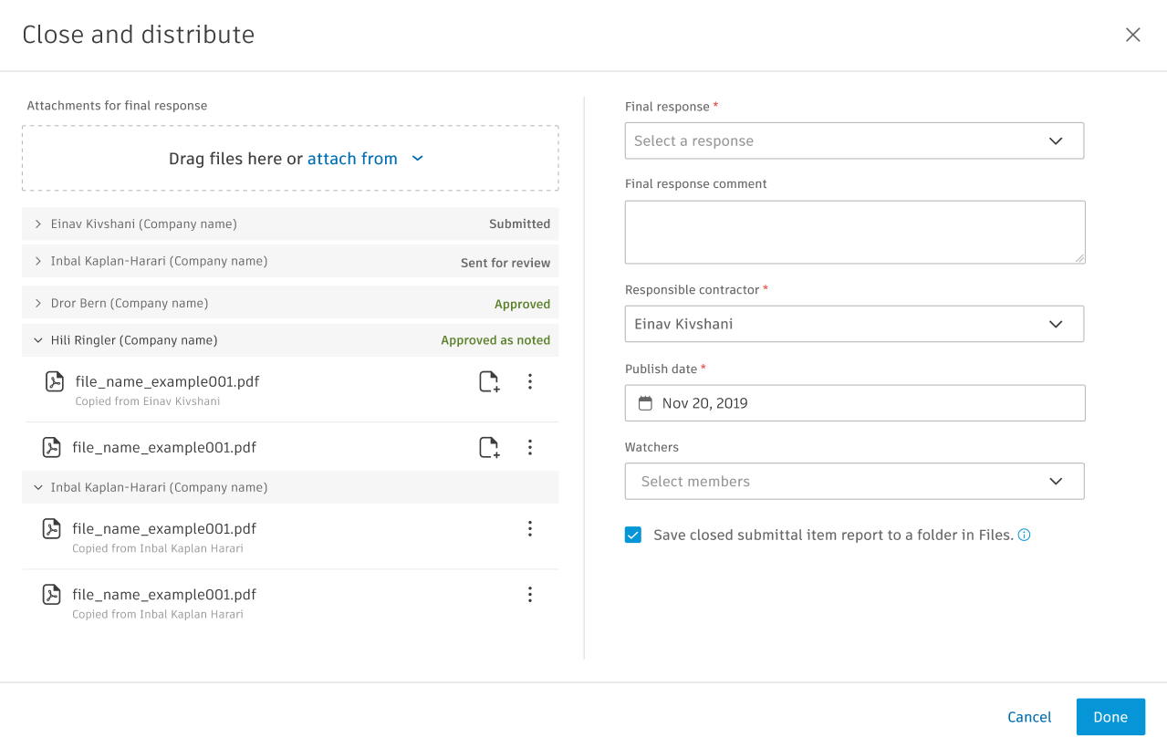
CONSTRUCTION ADMINISTRATION
SUBMITTALS:
ORB PROCEDURE
PROCORE

Slide 20
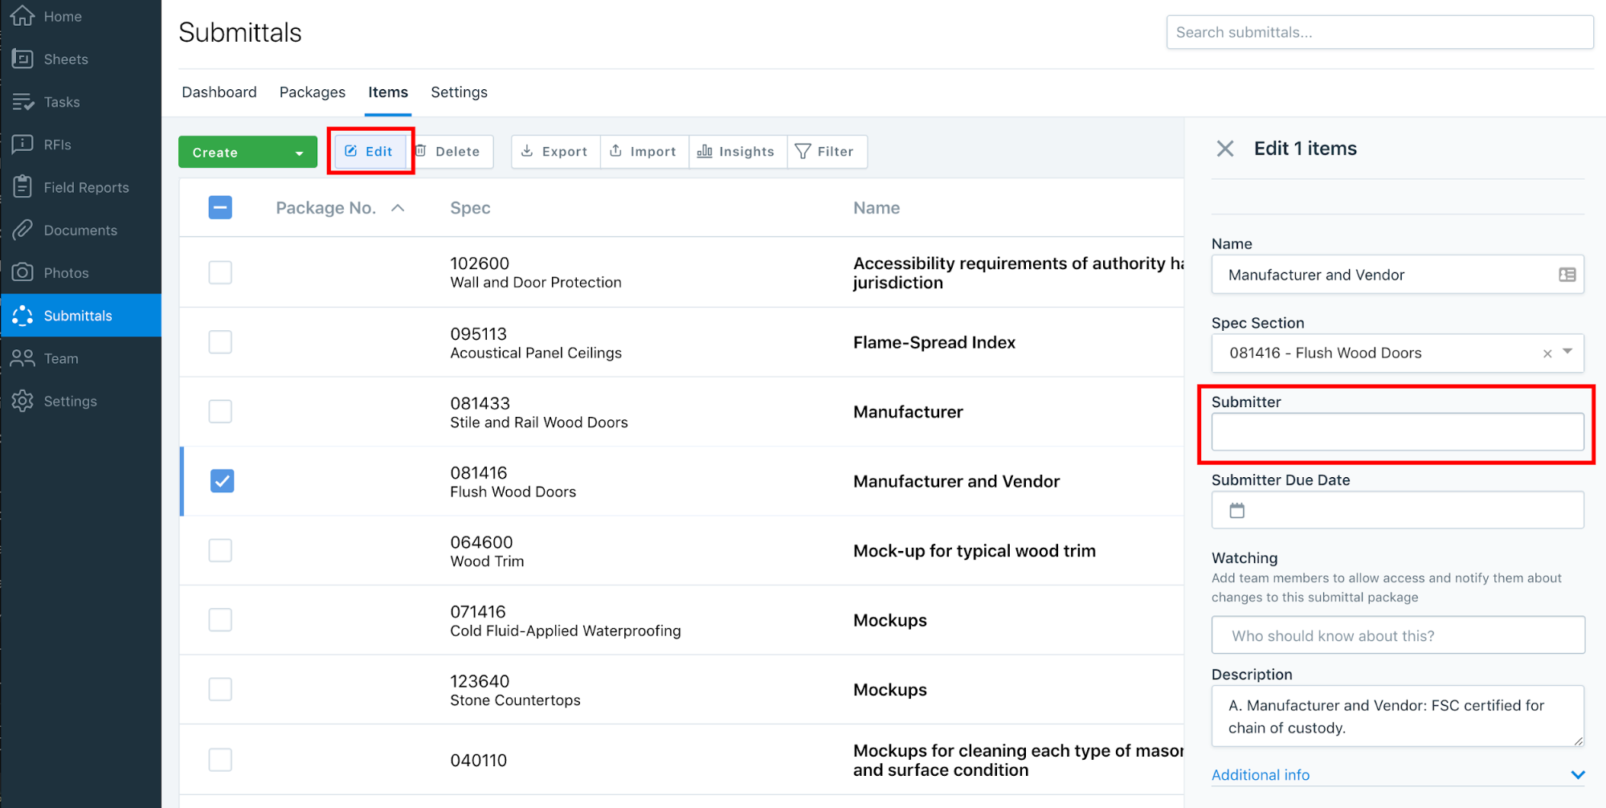
CONSTRUCTION ADMINISTRATION
SUBMITTALS:
ORB PROCEDURE
PROCORE
BUILD

Slide 21
CONSTRUCTION ADMINISTRATION
SUBMITTALS:
ORB PROCEDURE
PROCORE
BUILD
PLANGRID

Slide 22
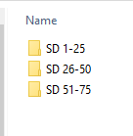
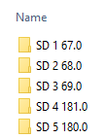
CONSTRUCTION ADMINISTRATION
SUBMITTALS:
ORB PROCEDURE
PROCORE
BUILD
PLANGRID

Slide 23
CONSTRUCTION ADMINISTRATION
SD _ # _ ## _ ORB Response
SUBMITTALS:
ORB PROCEDURE
ORB SUBMITTAL NUMBER
ORB FILES
Construction Administration / Submittals / SD…..

Slide 24
CONSTRUCTION ADMINISTRATION
SD _ # _ ## _ ORB Response
SUBMITTALS:
ORB PROCEDURE
CONTRACTOR / CLIENT SUBMITTAL NUMBER
ORB FILES
Construction Administration / Submittals / SD…..

Slide 25
CONSTRUCTION ADMINISTRATION
SD _ # _ ## _ ORB Response
SUBMITTALS:
ORB PROCEDURE
ORB Response
ORB FILES
Construction Administration / Submittals / SD…..

Slide 26
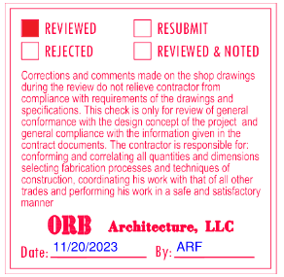
CONSTRUCTION ADMINISTRATION
SD _ # _ ## _ ORB Response
SUBMITTALS:
ORB PROCEDURE
ORB Response
CONSTRUCTION ADMINISTRATION LANGUAGE
REVIEWED

Slide 27
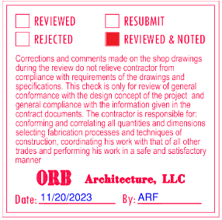
CONSTRUCTION ADMINISTRATION
SUBMITTALS:
ORB PROCEDURE
CONSTRUCTION ADMINISTRATION LANGUAGE
REVIEWED
REVIEWED AND NOTED

Slide 28
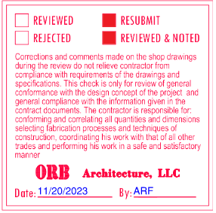
CONSTRUCTION ADMINISTRATION
SUBMITTALS:
ORB PROCEDURE
CONSTRUCTION ADMINISTRATION LANGUAGE
REVIEWED
REVIEWED AND NOTED
REVIEWED AND RE-SUBMIT

Slide 29
CONSTRUCTION ADMINISTRATION
SUBMITTALS:
ORB PROCEDURE
CONSTRUCTION ADMINISTRATION LANGUAGE
REVIEWED
REVIEWED AND NOTED
REVIEWED AND RE-SUBMIT
THE ARCHITECT DOES NOT APPROVE SUBMITTALS

Slide 30
CONSTRUCTION ADMINISTRATION
THE ARCHITECT DOES NOT APPROVE SUBMITTALS
SUBMITTALS:
ORB PROCEDURE
CONSTRUCTION ADMINISTRATION LANGUAGE
REVIEWED
REVIEWED AND NOTED
REVIEWED AND RE-SUBMIT

Slide 31
CONSTRUCTION ADMINISTRATION
SUBMITTALS:
PUT IT ALL TOGETHER

